Slide 1
Sql select
Continuous staff improvement project
Yurii Hohan

Slide 2
Introduction
Table Relationships
SELECT Statement.
Logical sequence of operations.
Everything is a table.
Sql projection.
Join, join types.
ORDER BY

Slide 3
Relationship types
One – to – One
One – to –Many
Many - to – Many

Slide 4
One – to – One
One record in Table A links exactly to one record in Table B.
Very often it means it should be joined into one table.
One exception is mapping inheritance, in that case Table B primary key is foreign key to Table A.
Example: Employees inherit from Person class. In that case Person will have a Primary Key, and the Employee table’s Primary Key will be foreign key to Person table.

Slide 5
One – to – Many
One record in Table A links to multiple records in Table B through the primary/foreign key fields of the two tables
Example: A list of suppliers for the music store is contained in Table A. It is linked by the supplier ID field to Table B which contains all of the products used by the music store.
When Table B is searched for a specific product (record), such as a CD carrying case, the manager can view the supplier’s contact information, which is stored in Table A.

Slide 6
Many – to – Many
Many-to-Many
Multiple records in multiple tables are linked by their primary keys through a Junction Table.
A many-to-many relationship is formed by connecting two or more tables that have a one-to-many relationship. The connection is made by a Junction Table.
Example. At University students attend lectures. One student can attend many lectures and one lecture is attended by many students. In this case, we create one JunctionTable – CourseResults. Very often, this table will soon grow with useful data, like Mark, PresencePercentage, etc.

Slide 7
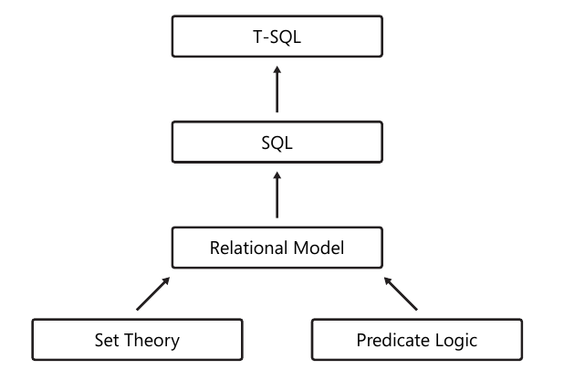
T-SQL

Slide 8
T-SQL
T-SQL, being based on standard SQL, is a declarative English-like language.
Declarative means you define what you want, as opposed to imperative languages that define also how to achieve what you want.
English-like manner. For example, consider the instruction, “Bring me a soda from the refrigerator.” Observe that in the instruction in English, the object comes before the location

Slide 9
SQL Select
The SQL SELECT statement is used to retrieve records from one or more tables in your SQL database.
As SQL is a declarative programming language, SELECT queries specify a result set, but do not specify how to calculate it.
The SELECT statement has many optional clauses:
PROJECTION specifies colums to retrieve
WHERE specifies which rows to retrieve.
GROUP BY groups rows sharing a property so that an aggregate function can be applied to each group.
HAVING selects among the groups defined by the GROUP BY clause.
ORDER BY specifies an order in which to return the rows.
AS provides an alias which can be used to temporarily rename tables or columns.

Slide 10
SQL Select Example
Based on the employees table below, select all fields from the employees table whose salary is less than or equal to $52,500
CREATE TABLE employees
( employee_number number(10) not null,
employee_name nvarchar not null,
salary int bigint,
CONSTRAINT employees_pk PRIMARY KEY (employee_number)
);
SELECT *
FROM employees
WHERE salary <= 52500;

Slide 11
From CLAUSE
The first clause to be evaluated logically.
You choose the table you want to query.
select e.empId, e.firstName, e.lastName
FROM Employees as e

Slide 12
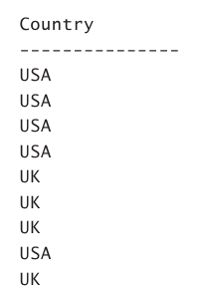
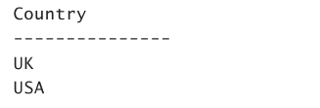
SQL Projection
SELECT country
FROM HR.Employees;
SELECT DISTINCT country
FROM HR.Employees;

Slide 13
SQL Projection Practices
Use alias for table and column names
SELECT e.country as CountryName
FROM HR.Employees as e;
Reason for table alias – when more than one table is used
Reason for column alias – when we want to rename the column names in the result.
Use asterisk (*) to select everything:
SELECT *
FROM HR.Employees as e;
SELECT e.*
FROM HR.Employees as e;
Warning – bad practice. Avoid, only reason is laziness.

Slide 14
SQL Projection Practices
Use TOP:
SELECT Top 4 e.country as CountryName
FROM HR.Employees as e;
Reason – get only part of rows. Always try to limit number of returned rows.
Warning – Always use TOP along with ORDER BY word, otherwise TOP might always return different results.

Slide 15
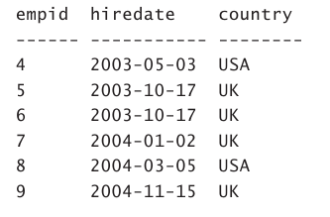
SQL WhERE Clause
Fillters rows based on the predicate in the WHERE clause. Only rows for which the predicate evaluates to true are returned.
SELECT empid, hiredate, country
FROM HR.Employees
WHERE YEAR(hiredate) >= 2003;

Slide 16
SQL WhERE Clause
WHERE Predicate
A predicate is a logical expression. When NULLs are not possible in the data (in this case, the country column is defined as not allowing NULLs), the predicate can evaluate to true or false. The type of logic used in such a case is known as two-valued logic. The WHERE filter returns only the rows for which the predicate evaluates to true.
When NULLs are possible in the data, a predicate can evaluate to true, false, and unknown. This type of logic is known as three-valued logic. You get an unknown when at least one operand is NULL; for example, NULL and WA, or even NULL and NULL. Predicate returns rows only when it evaluates to true.
Not equal a certain value with NULLable column, will not make the result set.

Slide 17
Is NULL, Is not null
How do we select only the records with NULL values in the "Address" column? With other words the records which have unknown Address:
SELECT LastName,FirstName,Address FROM Persons WHERE Address IS NULL
How do we select only the records with no NULL values in the "Address" column? With other words those whose Address we know:
SELECT LastName,FirstName,Address FROM Persons WHERE Address IS NOT NULL

Slide 18
Combining predicates
You can combine predicates in the WHERE clause by using the logical operators AND and OR. You can also negate predicates by using the NOT logical operator.
WHERE col1 = 'w' AND (col2 = 'x' OR col3 = 'y') AND col4 = 'z'
Combining with AND narrows the result and is faster, combining with OR widens the result.

Slide 19
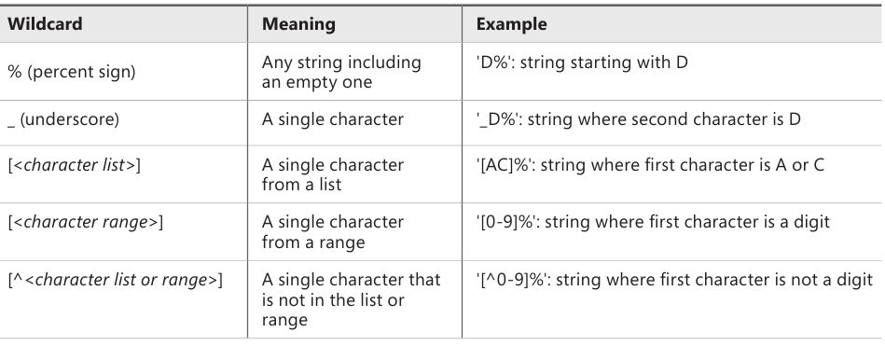
Filtering Character Data
Besides standard operators, T-SQL provides the LIKE predicate, which you can use to fillter character string data (regular and Unicode) based on pattern matching. The form of a predicate using LIKE is as follows.
<column> LIKE <pattern>
The LIKE predicate supports wildcards that you can use in your patterns.

Slide 20
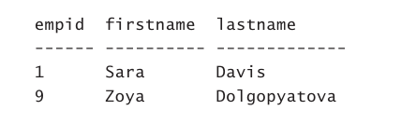
LiKE Example
SELECT empid, firstname, lastname
FROM HR.Employees
WHERE lastname LIKE N'D%';

Slide 21
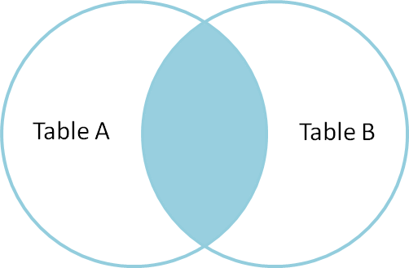
Join
Data that you need to query is spread across multiple tables. The more normalized the environment is, the more tables you usually have.
Use joins to query the data from the different tables and match the rows that need to be related.

Slide 22
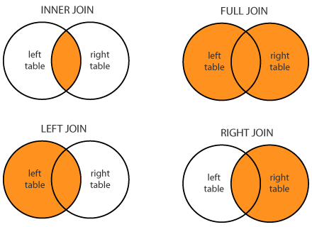
SQL Joins

Slide 23
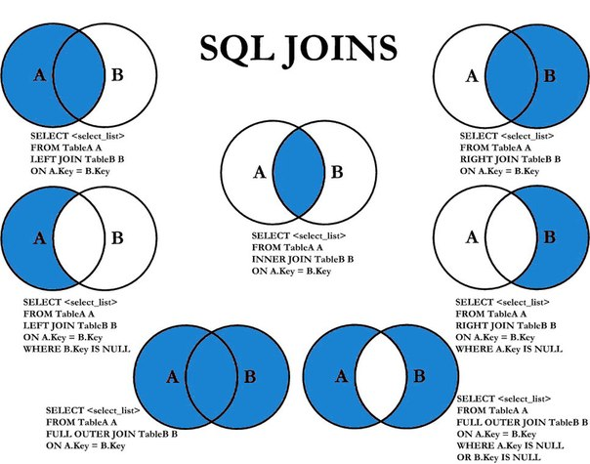
SQL Joins Extended

Slide 24
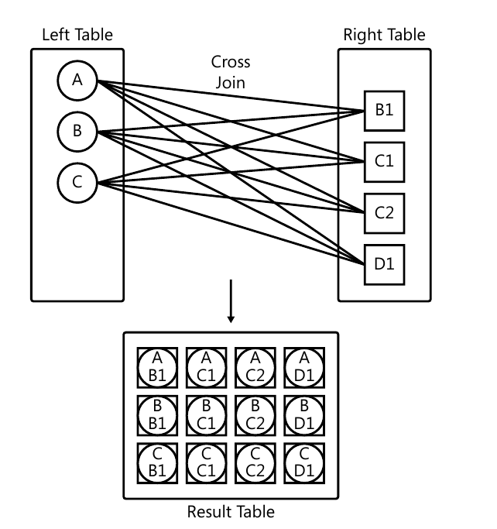
Cross Join

Slide 25
Cross Join
SELECT D.n AS theday, S.n AS shiftno
FROM dbo.Nums AS D
CROSS JOIN dbo.Nums AS S
WHERE D.n <= 7
AND S.N <= 3
ORDER BY theday, shiftno;
Mostly used to generate some data

Slide 26
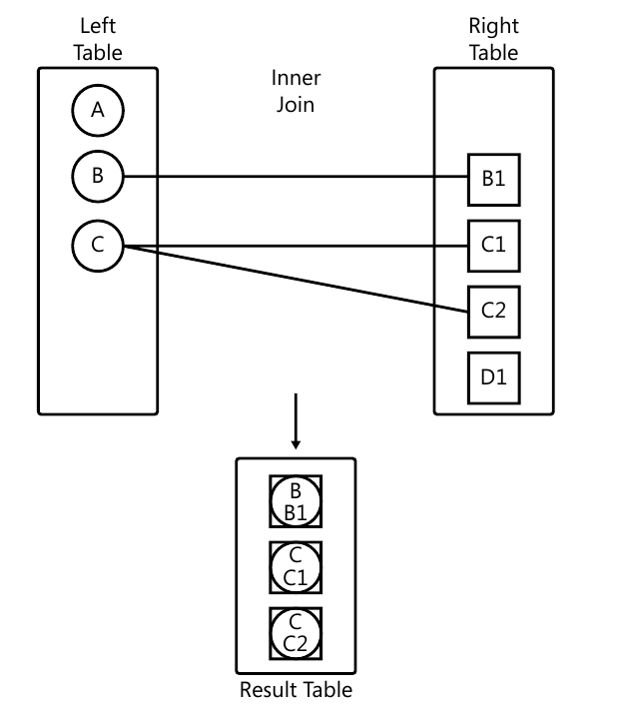
Inner Join

Slide 27
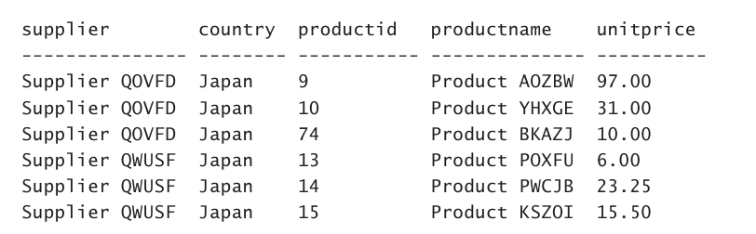
Inner Join
SELECT
S.companyname AS supplier, S.country,
P.productid, P.productname, P.unitprice
FROM Production.Suppliers AS S
INNER JOIN Production.Products AS P
ON S.supplierid = P.supplierid
WHERE S.country = N'Japan';

Slide 28
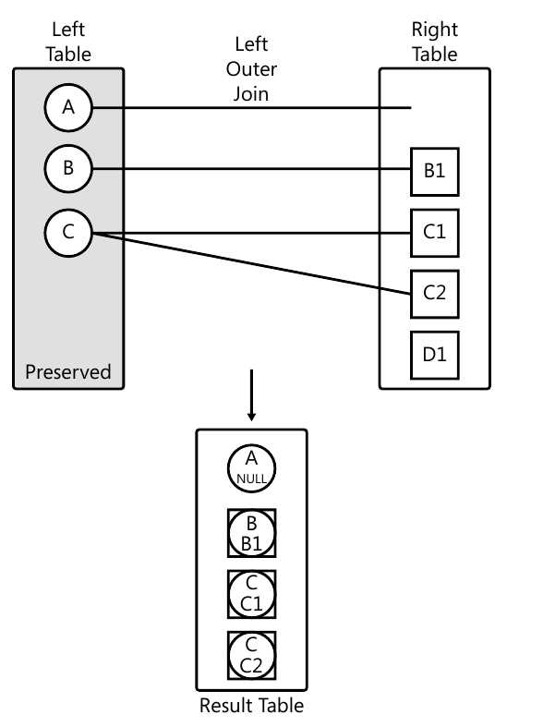
LEFT OUTER Join

Slide 29
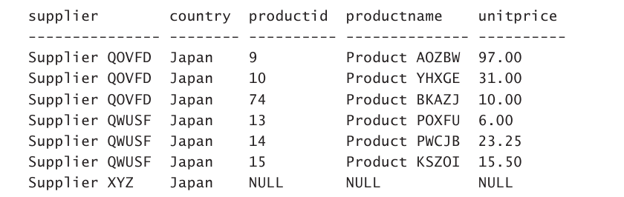
LEFT OUTER Join
SELECT
S.companyname AS supplier, S.country,
P.productid, P.productname, P.unitprice
FROM Production.Suppliers AS S
LEFT OUTER JOIN Production.Products AS P
ON S.supplierid = P.supplierid
WHERE S.country = N'Japan';

Slide 30
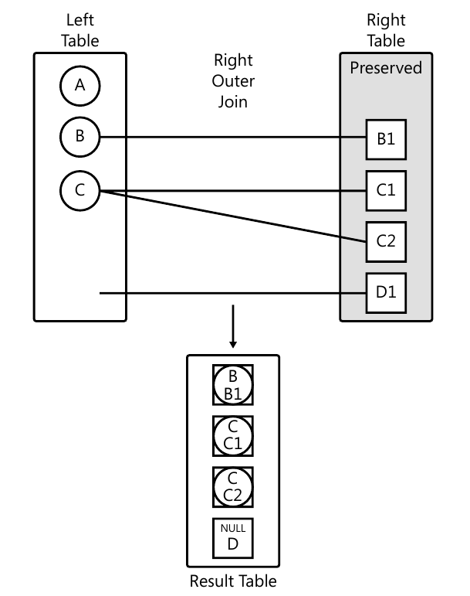
RIGHT OUTER Join

Slide 31
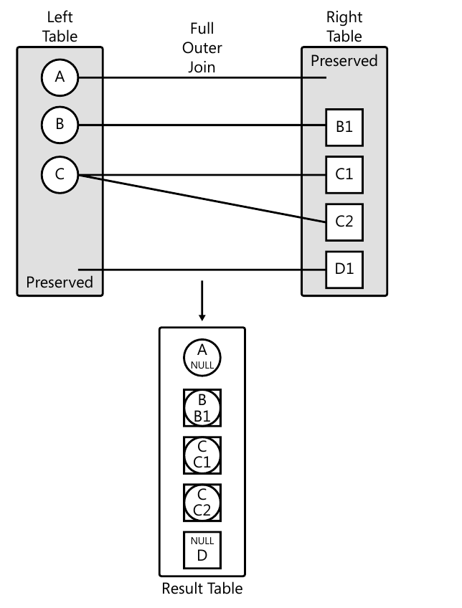
FULL OUTER Join

Slide 32
Multi-Join Queries
T-SQL takes place conceptually between two tables at a time.
A multi-join query evaluates the joins conceptually from left to right.
With inner and cross joins, the order cannot affect the meaning, with outer joins it can!

Slide 33
Everything Is a table. Projection
SELECT always return a table.
Even if it has one row and one column it is still a table.
It can be practically placed anywhere. E.g.:
SELECT SalesOrderNumber, SubTotal, OrderDate,
(
SELECT SUM(OrderQty)
FROM Sales.SalesOrderDetail
WHERE SalesOrderID = 43659
) AS TotalQuantity
FROM
Sales.SalesOrderHeader
WHERE
SalesOrderID = 43659;

Slide 34
Everything Is a table. JOin
SELECT
p.ProductID,
p.Name AS ProductName,
p.ProductSubcategoryID AS SubcategoryID,
ps.Name AS SubcategoryName
FROM
Production.Product p INNER JOIN
(
SELECT ProductSubcategoryID, Name
FROM Production.ProductSubcategory
WHERE Name LIKE '%bikes%'
) AS ps
ON p.ProductSubcategoryID = ps.ProductSubcategoryID;

Slide 35
Everything Is a table. WHERE
SELECT
BusinessEntityID,
FirstName,
LastName
FROM
Person.Person
WHERE
BusinessEntityID =
(
SELECT BusinessEntityID
FROM HumanResources.Employee
WHERE NationalIDNumber = '895209680'
);

Slide 36
Logical Query Processing Sequence
FROM
WHERE
3. GROUP BY
4. HAVING
5. SELECT
6. ORDER BY

Slide 37
Order By
If you do need to guarantee a specific presentation order to the rows in the result, you need to add an ORDER BY clause to the query.
No ORDER BY – No order! It may break in one case out of the 1000, but it will.
The only clause which breaks the relational principle – it is not a set anymore, but a list
SELECT empid, lastname
FROM HR.Employees
ORDER BY empid;

Slide 38
Order By. Two columns
You can sort first on one column, then on the second column in case of a tie.
You can sort on aliases from projection since ORDER BY is the last one in query execution.
SELECT country, YEAR(hiredate) AS yearhired, COUNT(*) AS numemployees
FROM HR.Employees
WHERE hiredate >= '20030101'
GROUP BY country, YEAR(hiredate)
HAVING COUNT(*) > 1
ORDER BY country , yearhired DESC;

Slide 39
Assignment
Write Projection Queries for Your Domain.
Write Filtering queries (Use is Null logic, use like for Nvarchar, combine predicates).
Use Joining queries – inner join, outer joins.
Join more than two tables.
Use Order By to get Ordered resulT

